Slide 1
Are You Hungry
5100 Final Project
Take-Away Service
Chrome: Zhonghao Gu, Mengyu Zhu, Shuai Shao

Slide 2
Content
1 / Problem Statement
2 / Solution
3 / Approach
4 / Design
5 / Use Case
6 / Workflow
7 / Key Screenshot

Slide 3
Problem Statement
Due to the fast-pace of life, meal time has been shrunk shorter and shorter for people, not to mention the time preparing for meals, so more people are willing to dine out.
However, there comes two problems, the amount of restaurants nearby is not too much, so we don't have too much choice. Another is the traffic problem while choosing further restaurants. In that case, we need to spend a lot of time on that. So how should we resolve these troubles?

Slide 4
Solution
Our Take-Away Service is one possible way to solve this problem. Customers only need to swipe their fingers to order dishes,and the dishes will be delivered in 1 hour generally. There are plenty of restaurants to choose in our APP, and time on the road will be saved. Our APP is designed to aim at these issues.

Slide 5
Approach
► Customers can order foods from restaurants existing in certain network, then Restaurants accept the order. After making it, they will pass it to delivery man. After Deliveryman send it to customer, Customer could confirm delivery.
►Suppliers have their daily delivery task to restaurants. You can add the stuff from table, after finishing it, the Restaurant could confirm delivery.
►When Restaurants are short of some material, they can request some from Suppliers. When suppliers get the message they will send it to restaurant. After delivery, restaurants could confirm it.

Slide 6
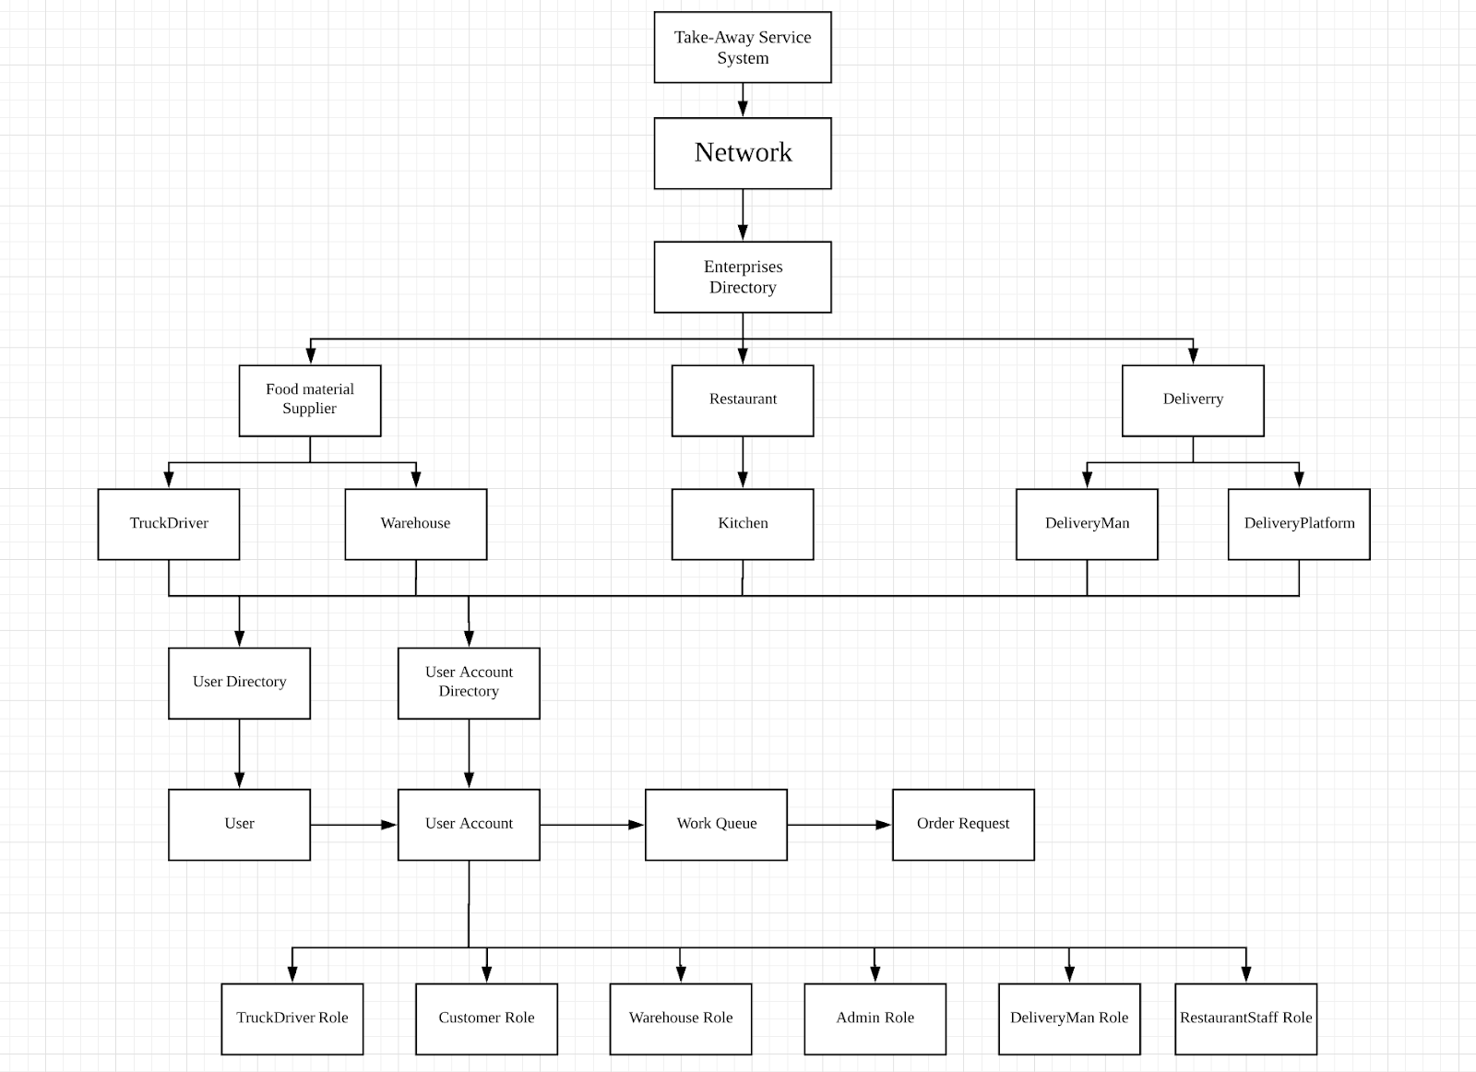
Design

Slide 7
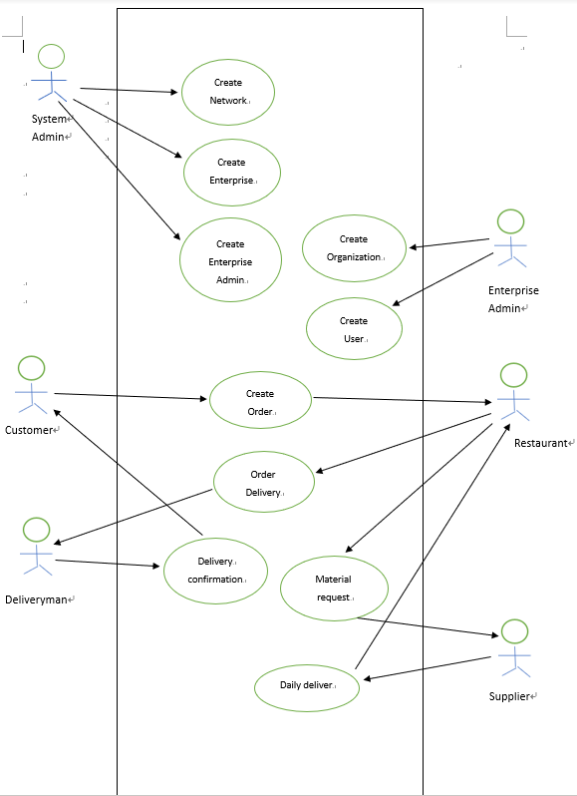
Use Case

Slide 8
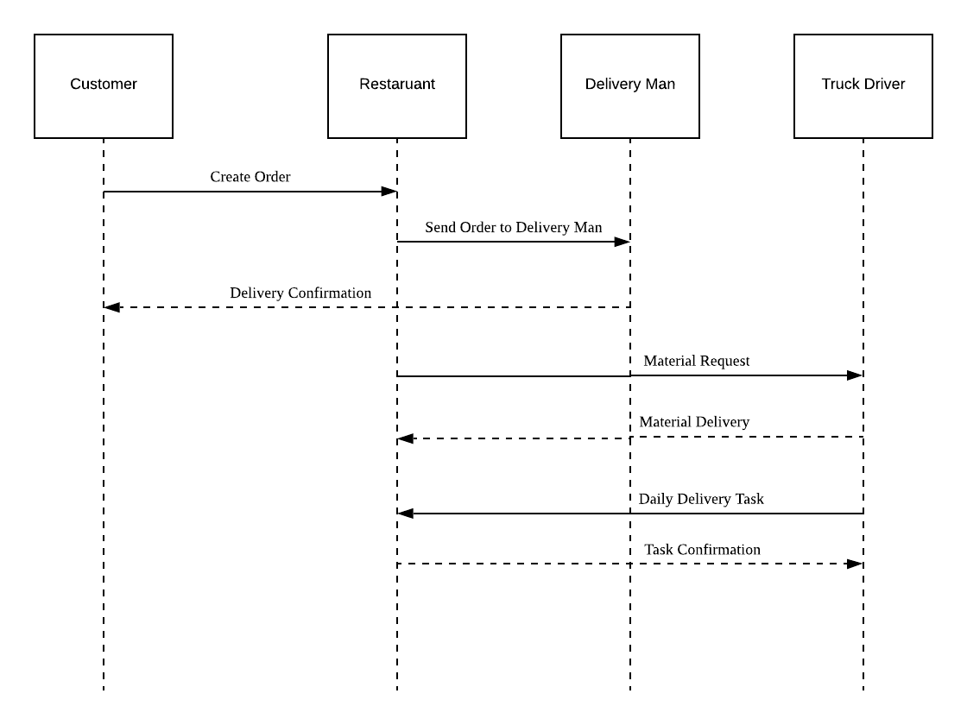
Workflow

Slide 9
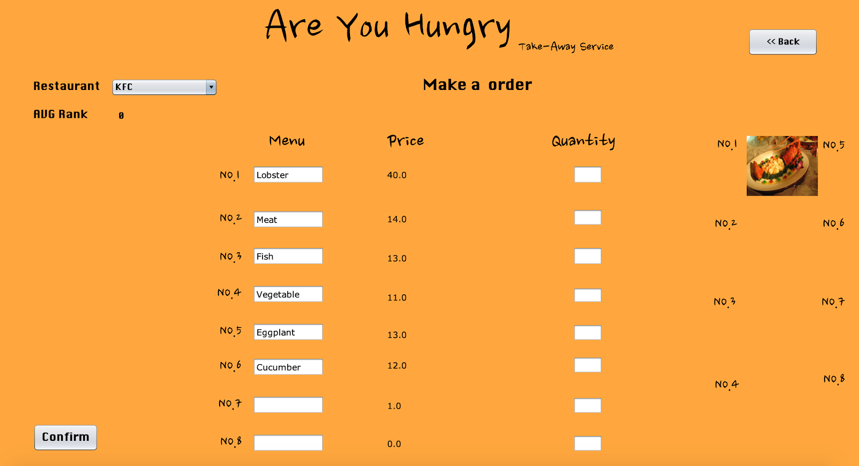
Key Screenshots customer order dishes

Slide 10
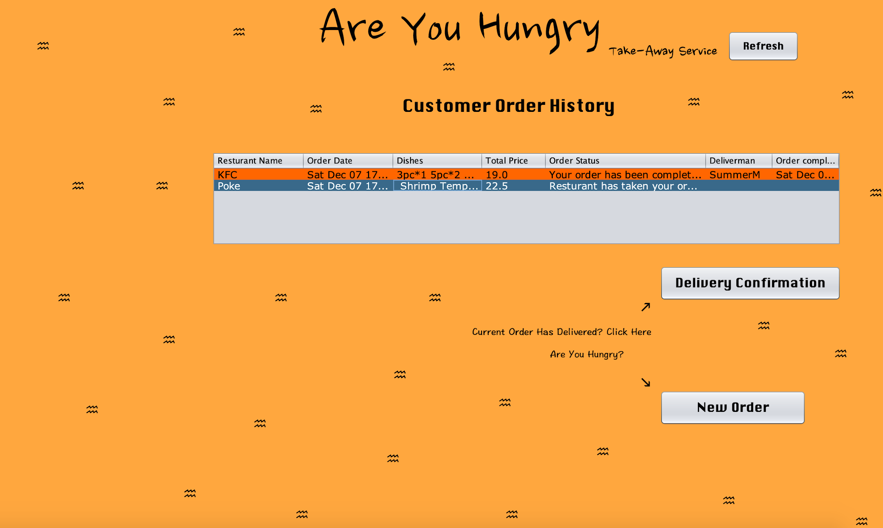
Customer Order History

Slide 11
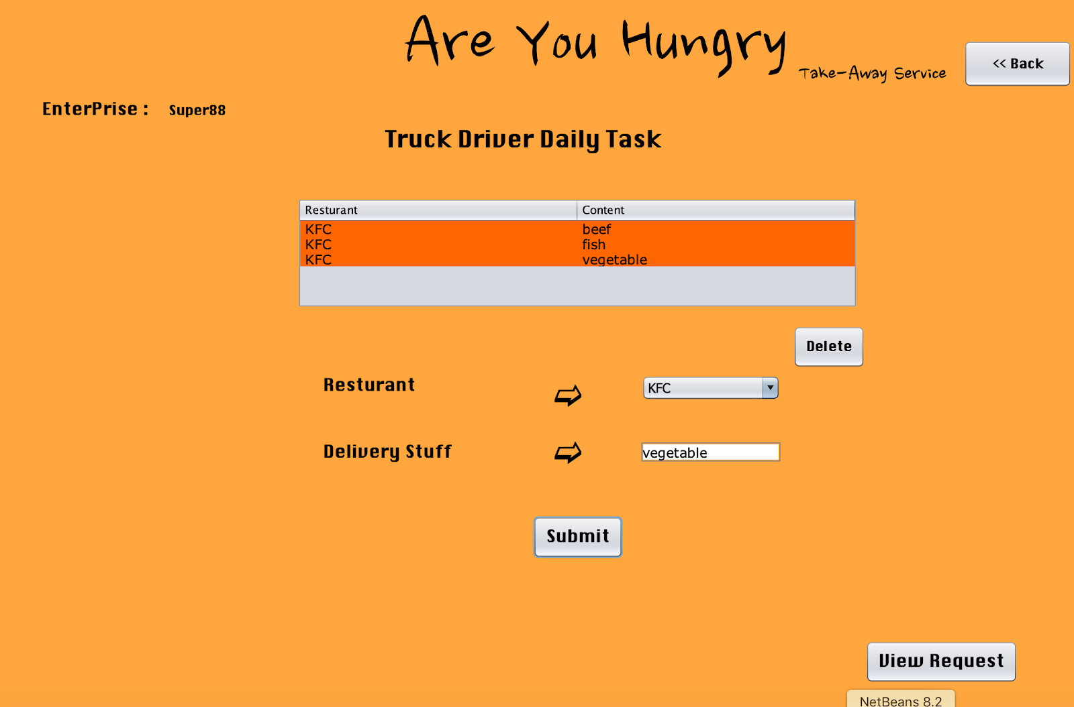
Truck Driver Add Daily Task

Slide 12
Thanks For Watching

Slide 13

Q&A

